Slide 1

Age estimation from images with DCNN
Artificial Vision, 2020/21
Group 11: De Simone Giuseppe, Giaquinto Gennaro, Marino Christian, Serritiello Simone

Slide 2
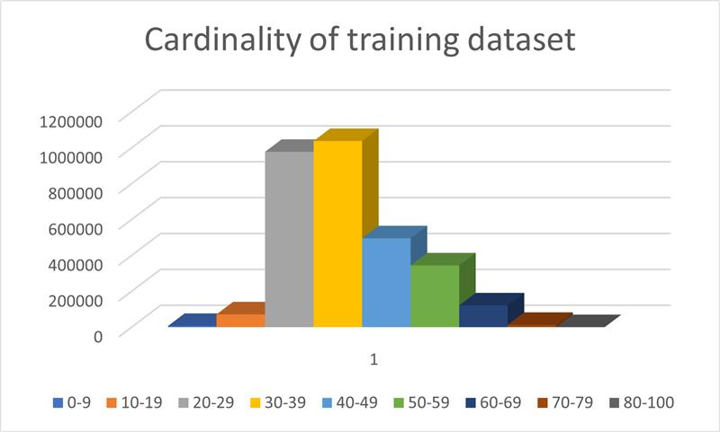
Introduction
Nowadays, age estimation is a tough task:
Low number of training samples available for certain age ranges;
Different variations of age in some ranges than others;
Variations in age differs from subject to subject;
Classic problems of face images in the wild (occlusions, light, noise, …)

Slide 3
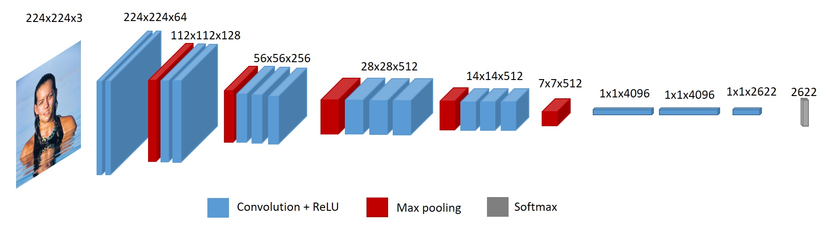
Solution
The solution consists in a CNN that takes in input a 224x224x3 image and outputs the age as a classification over all 101 available classes;
It has been implemented using the Transfer Learning method over VGG-Face2 used as backbone for feature extraction:
Weigths of VGG layers have been freezed
2 trainable additional layers:
1024 and 101 neurons respectively
Activation function on last level: softmax

Slide 4
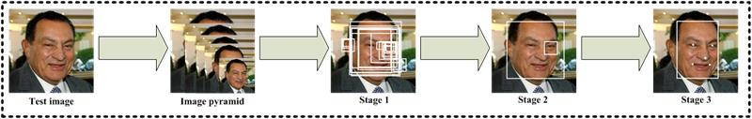
Face Detection
For the face extraction task, the MTCNN (MultiTask Cascaded Convolutional Neural Network) has been used:
It provides higher performance, mainly on occluded and lateral images
Consists in 3 convolutional stages that extract faces sequentially with higher accuracy

Slide 5
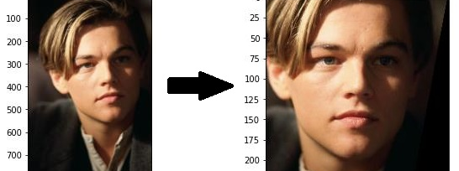
Face Pre-Processing
Pose normalization task has been perfermed though a framework (imutils face aligner based on a dlib facial landmarks predictor):
It’s based on the position of facial landmarks
It’s better than «best score» methods

Slide 6
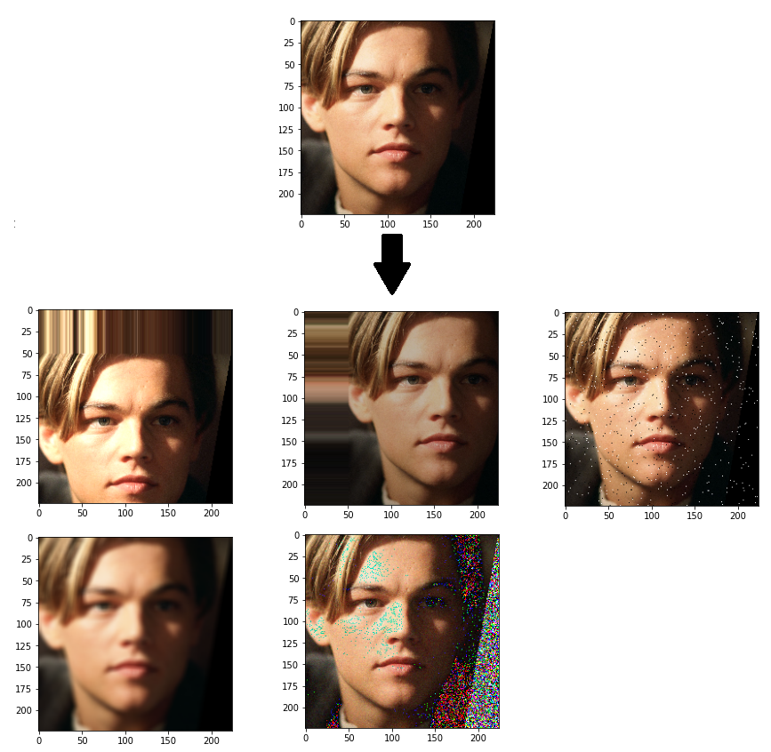
Data Augmentation
Data augmentation has been performed based on age ranges:
For ranges that present a lower cardinality, the latter has been improved by adding 5 altered images from a single one;
For other ranges, given the huge amount of pictures, the focus of augmentation has not been to incease the number of samples but just to improve the representativity of images:
Wild noises like random blur, gaussian and sp noises;
Alteration of the brigthness;
Horizontal and vertical shift.

Slide 7

Training procedure
Training has been done in incremental way, with:
Optimizator: Adam (Adaptive Momentum estimation), based on Stochastic Gradient with a additive estimation of the momentum;
Keras API «ReduceLROnPlateau» that handle the scheduling of the learning rate and the early stop: if the specified metric doesn’t improve for a «patient» number of epochs, the learning rate is decremented with a factor of 10;
Batch size: 60, epochs: 5, initial learning rate: 0.001, patient number: 2;
Loss function: Categorical Crossentropy

Slide 8
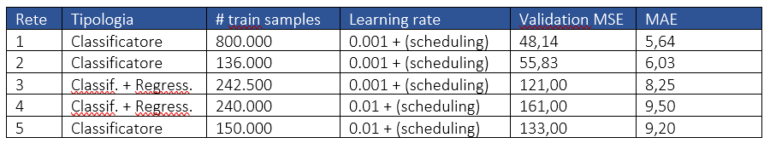
Experimental Results
These nets has been trained:
The one presented;
A CNN similar to #1 but with a dropout level (dropout=0.2);
A single multi-classificator for 5 age ranges with other 5 range-specialized regressors;
A multi-classificator similar to #3 but trained with Fine Tuning (on all the levels of VGG-Face) and with 3 additional levels at the end of it;
A CNN similar to #1 but trained with Fine Tuning and optimizator SGD, learning rate=0.01, momentum 0.9 and 3 dense layers with Dropout=0.5

Slide 9
Thanks for the attention
Group 11

